Slide 1




S H ORT- T E RM RE N T A L P E R M I T T I N G
Ci ty o f Fo re st Pa r k
D e p a r t m e nt of P l a nni ng & Com muni t y D eve l op m e nt

Slide 2

W H A T I S A S H O RT- T E R M RE NT A L PROPERTY ?
The City of Forest Park Code of Ordinances defines a short-term rental as an accommodation where, in exchange for compensation, a residential dwelling unit is provided for lodging for a period of time not to exceed thirty (30) consecutive days.

Slide 3
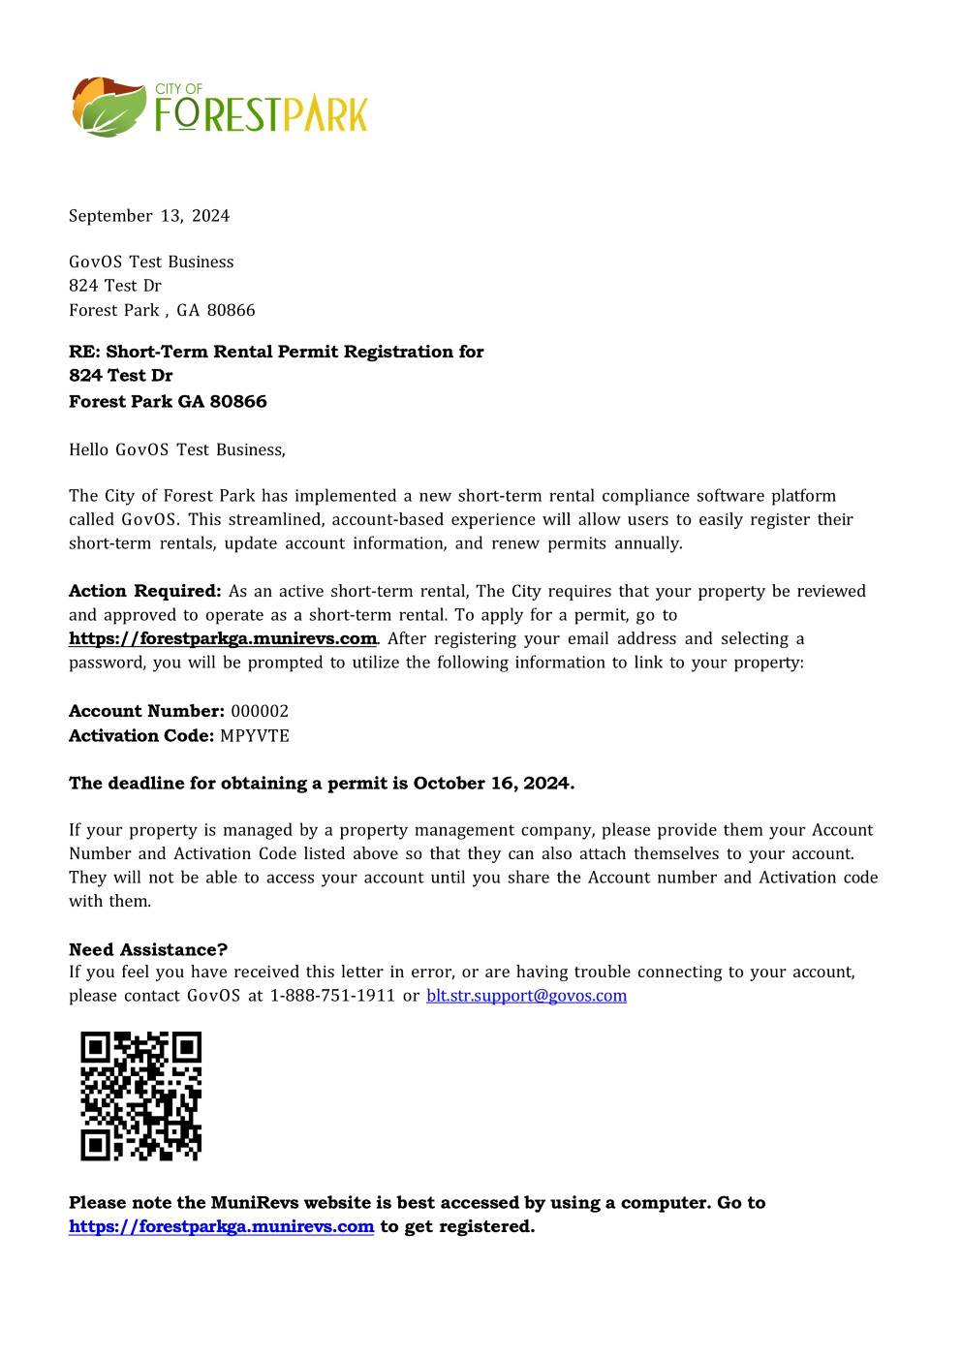

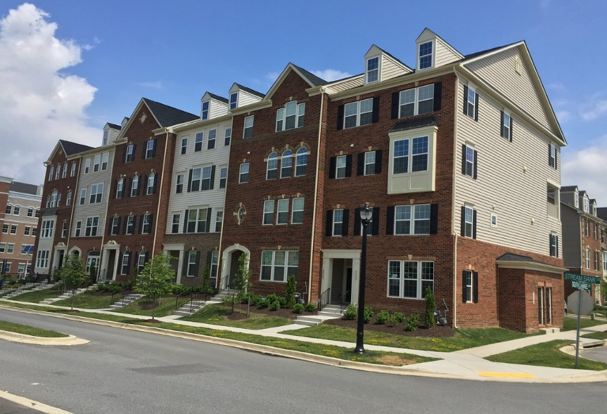

Slide 4
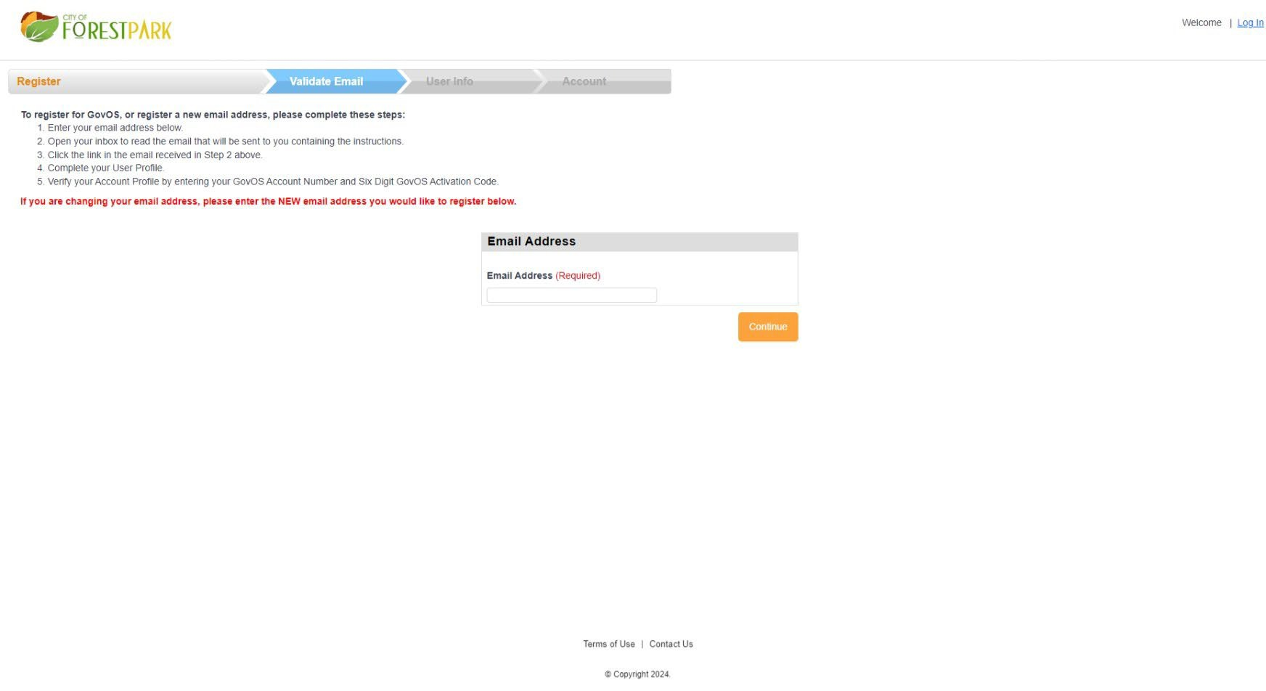

Slide 5
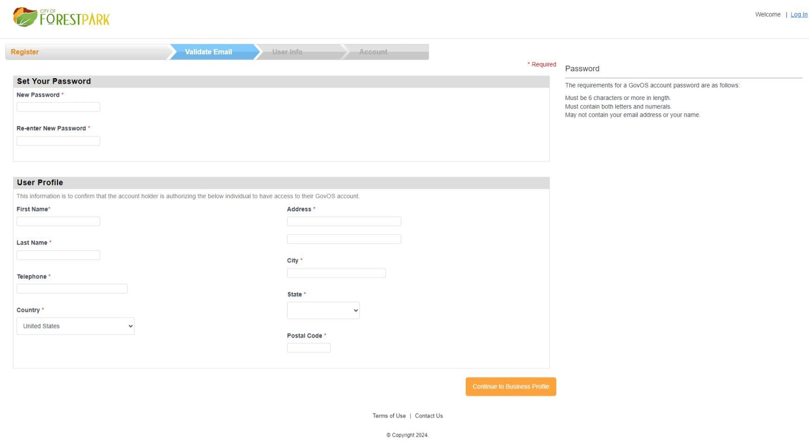
FIRST RESPONDERS OF INFORMATION

Slide 6
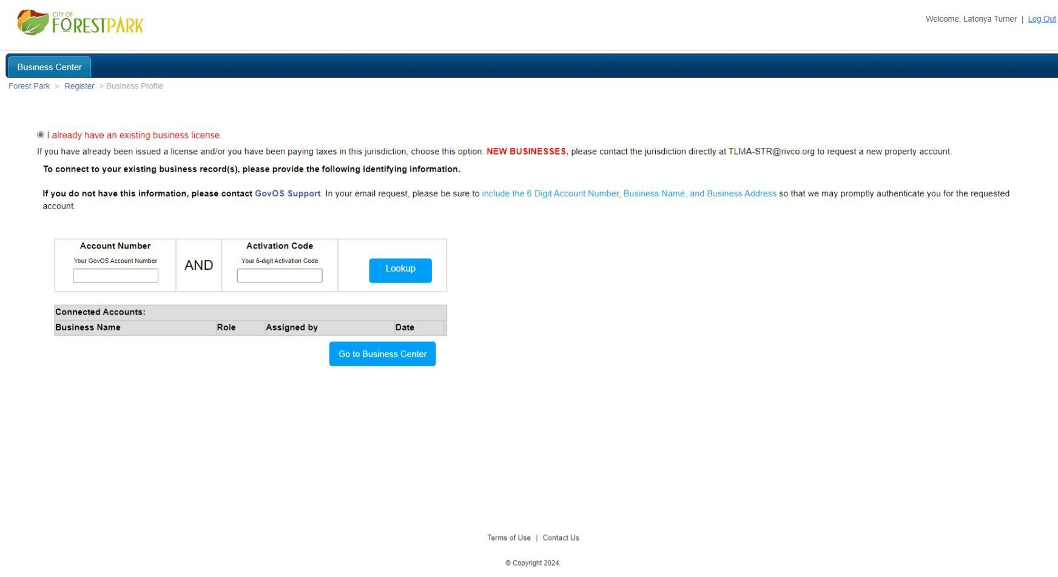
FIRST RESPONDERS OF INFORMATIN

Slide 7
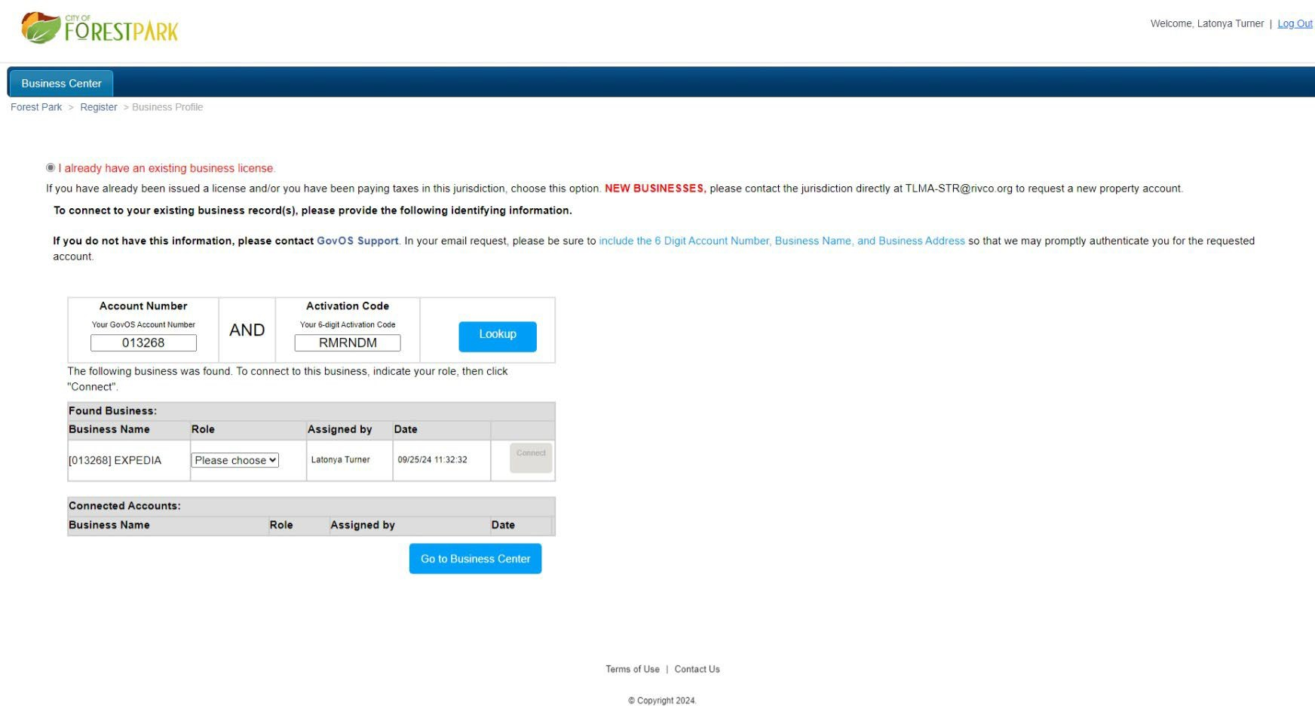
FIRST RESPONDERS OF INFORMATIN

Slide 8
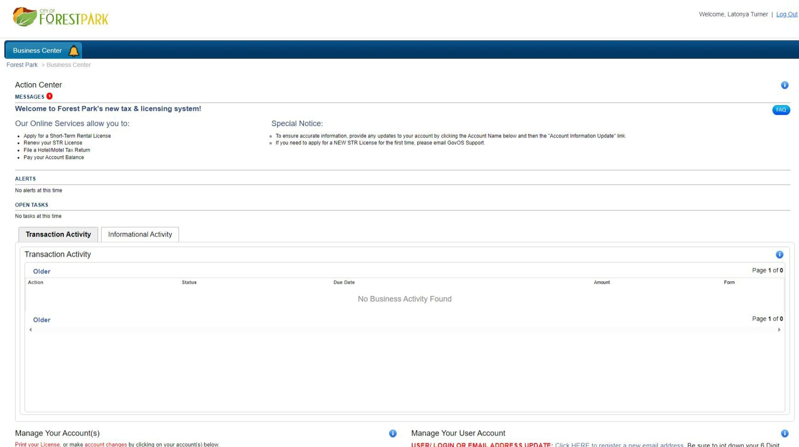
FIRST RESPONDERS OF INFORMATIN

Slide 9
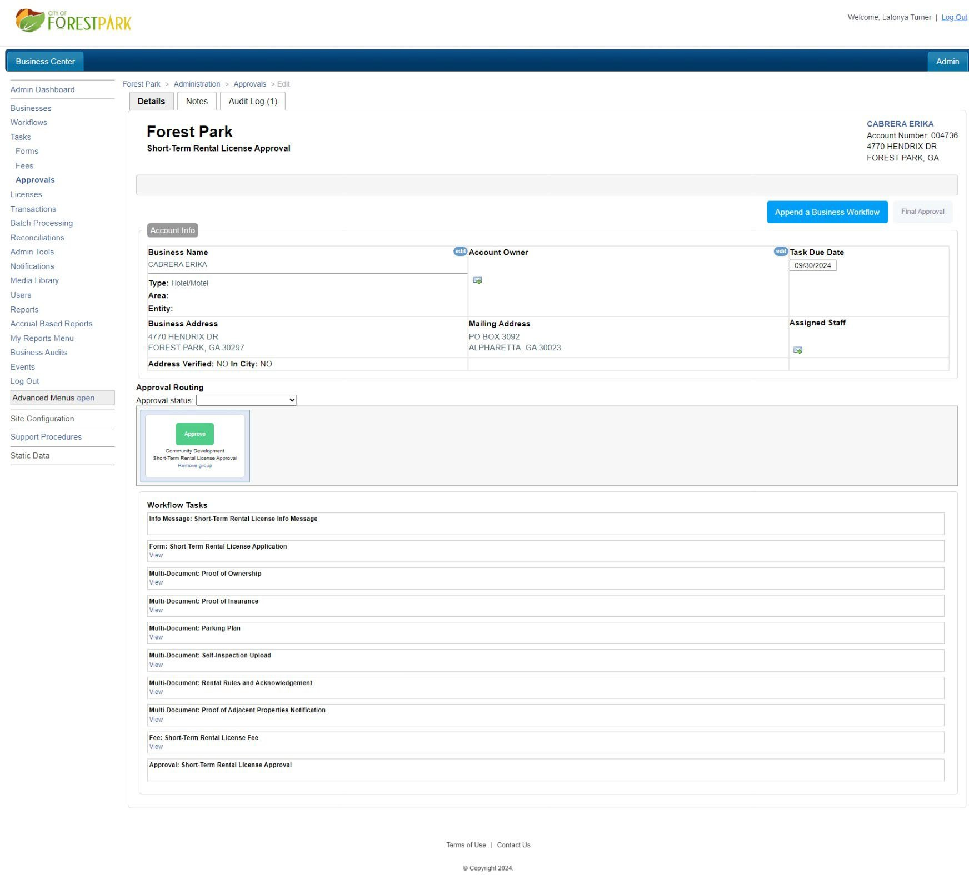
FIRST RESPONDERS OF INFORMATIN

Slide 10
S H O RT- T E R M R E N T A L
R E G U L A T I O N S
No person or entity shall, rent, lease, or otherwise exchange for compensation all or any portion of a dwelling unit as a short-term rental unit without a short-term rental license.
No licensee shall transfer the right to operate under any license issued to any other person or entity by lease, agreement, contract, or any other agreement.
No license issued may be operated or shall have any legal effect at any location other than those for which it is issued.
FIRST RESPONDERS OF INFORMATIN

Slide 11
REQUIREMENTS
No person or entity shall, rent, lease, or otherwise exchange for compensation all or any portion of a dwelling unit as a short-term rental unit without a short-term rental license.
No licensee shall transfer the right to operate under any license issued to any other person or entity by lease, agreement, contract, or any other agreement.
No license issued may be operated or shall have any legal effect at any location other than those for which it is issued.
FIRST RESPONDERS OF INFORMATIN

Slide 12
And Now You Have Completed The Process!
Thank you!
If you have any questions contact the following:
Registering- Permitting & Licensing Division
Business Taxes and Fees - Finance Department
Rules and Requirements- Code Compliance
FIRST RESPONDERS OF INFORMATIN

Slide 13
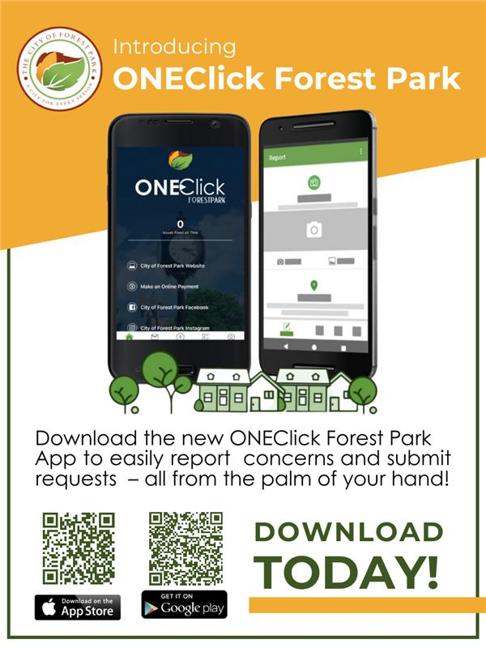

Stay Informed & Connect With Us Online!
FIRST RESPONDERS OF INFORMATIN

