Slide 1

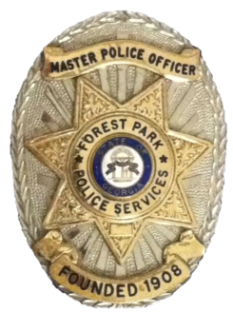
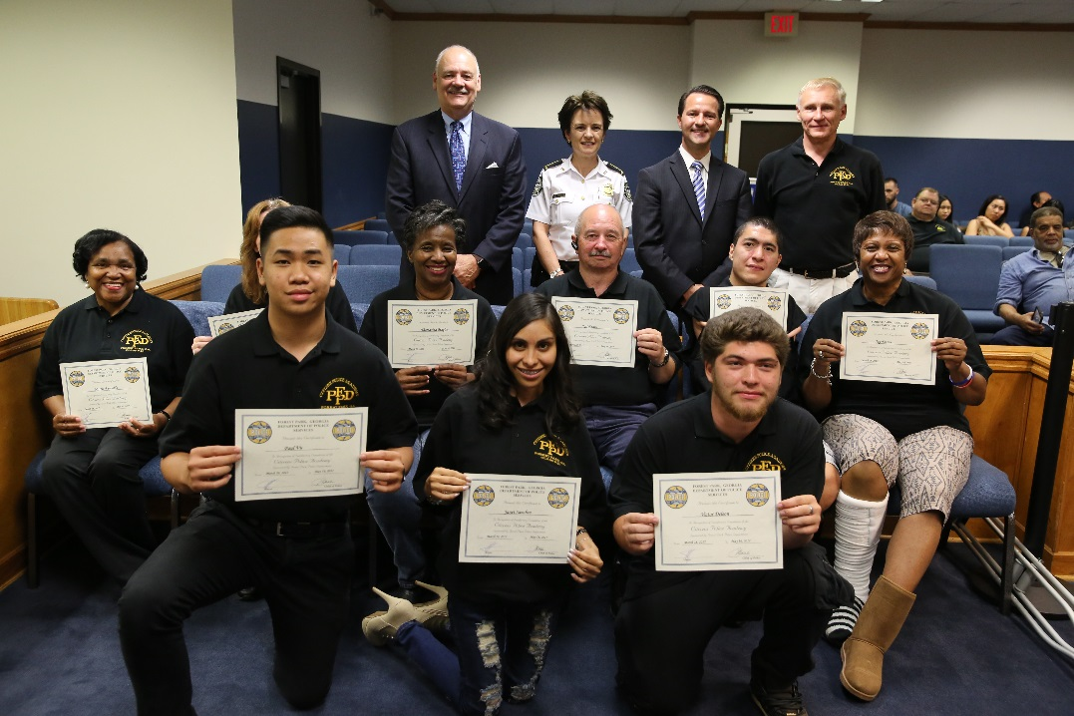
The Guardian
Annual Report 2017
Preventing Crime
2017 Citizen’s Police Academy
With Community Partnerships

Slide 2
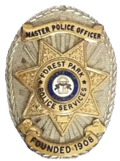
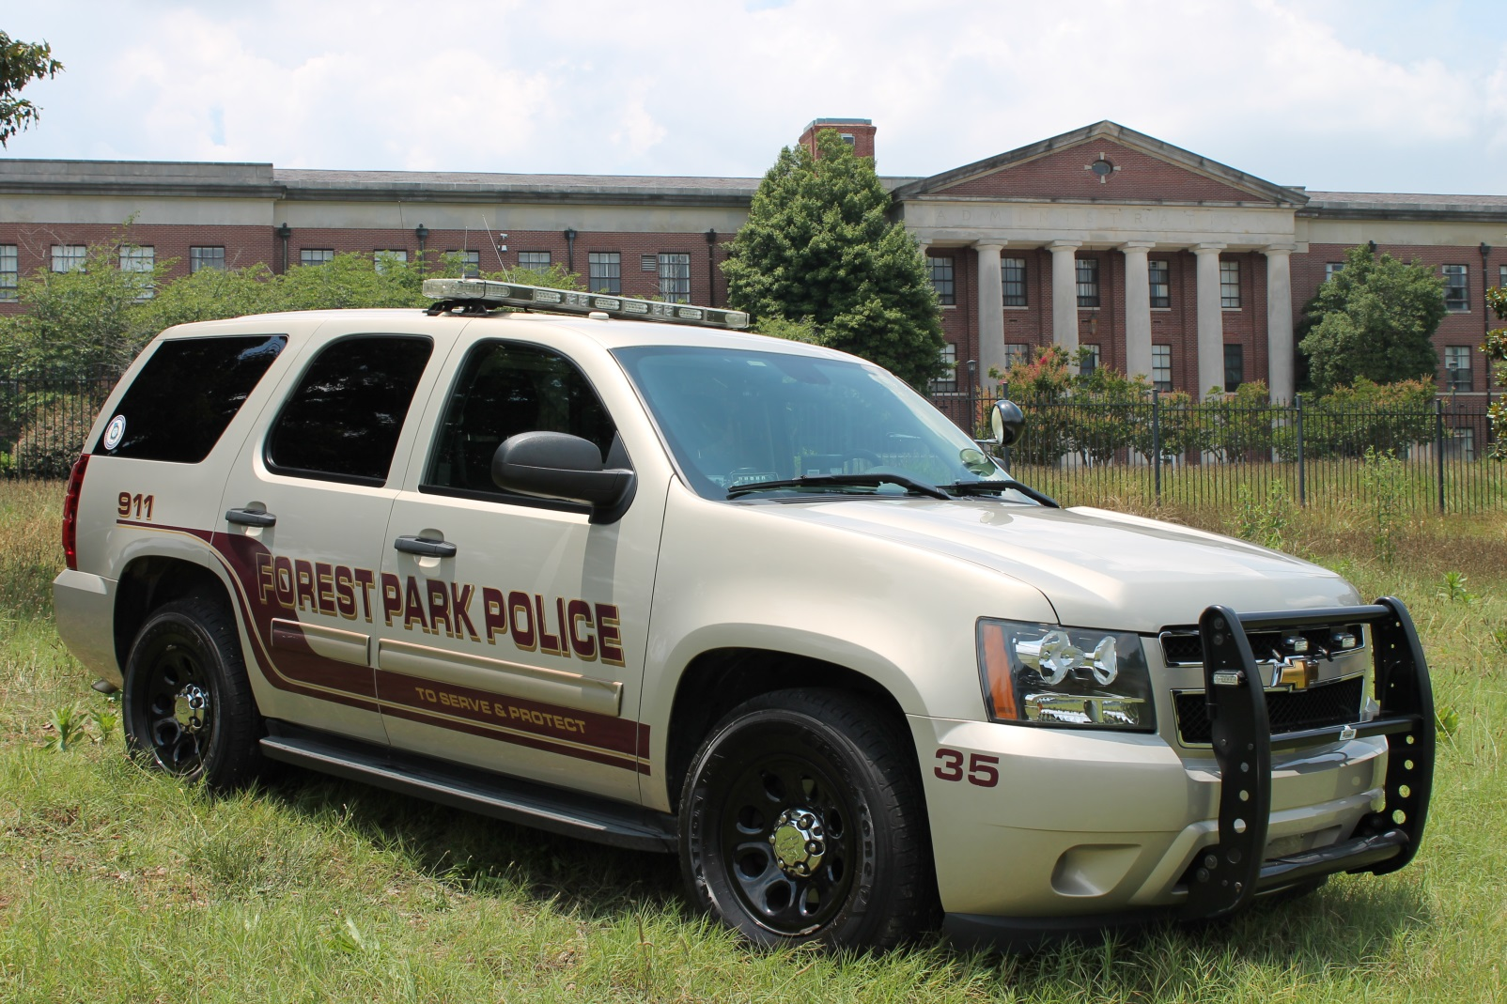
Table Of Contents
Chief’s Message - ---------------3
Mission Statement ------------- 4
Accreditation--------------------5
Records & Court Services -----7
Operations Division ------------10
Patrol Team Commanders------11
Patrol Goals ---------------------12
Accident reduction -------------13
Part I Crimes-------------15
Internal Affairs ---------- 17
COPS Unit -------------- 20
Training-------------------21
Firearms Training ------- 22

Slide 3
CHIEF OF POLICE
L. Dwayne Hobbs
Chief Hobbs is a native of Forest Park, where he attended grammar school, middle school and graduated Forest Park High School in 1972. He joined the police department in July 1973 as a patrol officer and worked his way through the ranks and was appointed Chief in April of 1996.
He obtained his Associates Degree from Clayton State University, his Bachelors and Masters Degree from Columbus State in Criminal Justice and Public Administration.
Chief Hobbs is also a graduate of the Georgia Chiefs Association's Class I - Command College; he graduated the 163rd Session of the FBI-National Academy; he was a member of the 13th Delegation of Georgia State University’s Georgia-Israel Law Enforcement Exchange program; he is a POST certified instructor; the past chairman of the Region Seven All-Hazards Council; Chairman of City’s Retirement Board; past District 10 Vice President of Georgia Chiefs Association; and an adjunct professor at Clayton State University.
Chief Hobbs has amassed over 10,000 training hours including advanced instruction from the International Association of Chiefs of Police and the Georgia Peace Officer Standards and Training Council in a multitude of law enforcement disciplines including Emergency Management, Disaster Planning, Emergency Response, and Police and Fire operations. He holds several law enforcement certifications including Basic, Intermediate, Advanced, Supervisory, Management, Executive, General Instructor, and Advanced Instructor.
The Forest Park Police Department, under his leadership, has been internationally accredited by the Commission on Accreditation for Law Enforcement Agencies for fifteen consecutive years and has been recognized by the Georgia Chiefs Association’s Certification Program for the past seventeen years.

Slide 4
A message from the Chief…
  It is with great pleasure we present to you the 2017 Annual Report, a short summary of activities and crime prevention efforts that occurred throughout the year. The police department strategies are a composite of contemporary law enforcement initiatives blended with practical, and traditional methods of law enforcement. In trying to achieve multiple objectives, like crime control, traffic enforcement, accident reduction, and community outreach, we have at our disposal a variety of effective tactics and strategies.
  Some think the way police achieve public safety objectives is solely through enforcement initiatives, when in reality the police do much more than enforce the laws. In fact, most police/civilian interactions do not involve an arrest or even a citation.
  When viewing policing, in light of the objectives and methods described, it becomes more sensible to acknowledge that enforcing the law is not the end in itself, but rather one means among several methods available to the police. We subscribe to Sir Robert Peel’s philosophy of 1829 when he said “The police are the public and the public are the police.” With citizen and business partnerships cultivated, we can help the public understand the capabilities and limitations of law enforcement.
  Through our outreach programs and community policing philosophy we try to craft a balanced approach to enhance community knowledge and achieve citizen support and oversight into our police initiatives.
  In 2017, we saw a 2% increase in Part I crime; since the implementation of Community Policing in 1996, the city has enjoyed a 59% reduction in crime.
  We believe with this philosophy we will demonstrate our accomplishments with a variety of safety initiatives and outreach programs. Of course, we can’t provide everything in this report, but we think it is important to summarize the activities to give you some idea of what we are doing and how we do it.
  It is our sincere desire to provide you with effective, efficient, and professional law enforcement services. In doing so, we strive to promote excellence in everything we do, and to encourage open communications while actively seeking your assistance in making Forest Park a safer city.
L. Dwayne Hobbs
Chief of Police
3

Slide 5
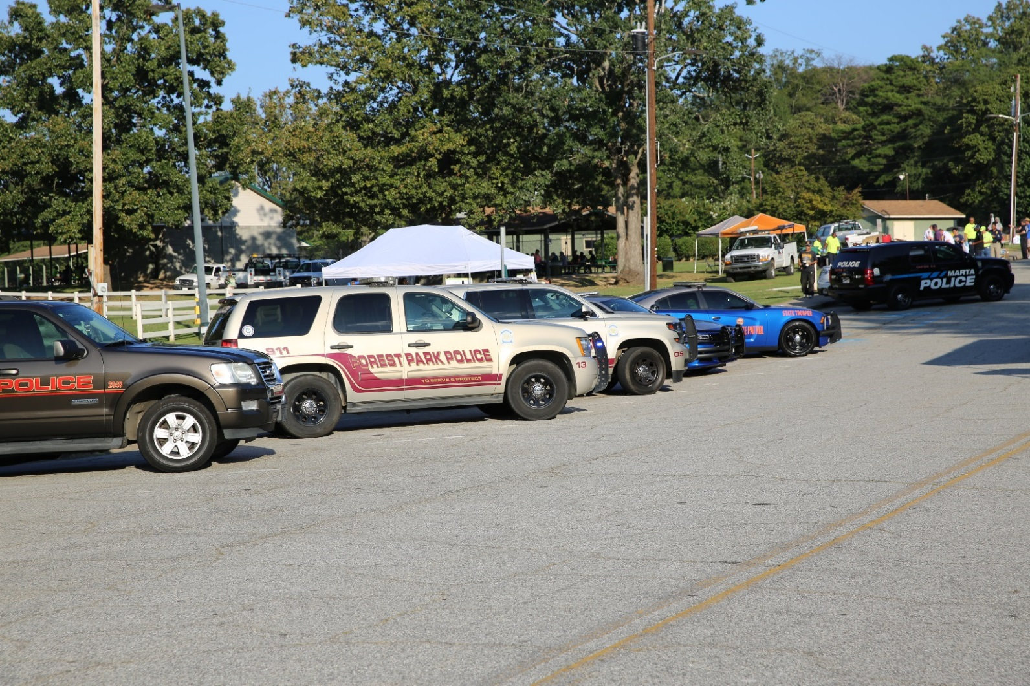
OUR MISSION
2017 Forest Park Police Department National Night Out
The Forest Park Police Department will deliver effective and responsive law enforcement services to all the citizens in a fair and equitable manner.
As an integral part of the community, we are committed to communicate with those we serve and to join with them in establishing priorities to enhance the quality of life for the entire city.
4

Slide 6

Accreditation & Certification
The Forest Park Police Department was awarded its fifth reaccreditation in March of 2017. The accreditation process is voluntary and on-going. We constantly evaluate policy and procedures to ensure best practices are performed. The Commission on Accreditation for Law Enforcement Agencies recognizes the professional excellence of agencies internationally, and we have sustained this prestigious award for fifteen consecutive years by achieving the 462 standards of distinction.
Forest Park has also participated in the Georgia Association of Chiefs of Police State Certification program for nineteen years, and was recertified in 2017.
5

Slide 7
Assistant Chief
Tommy Orr
Colonel G. T. “Tommy” Orr is a graduate of Forest Park High School, class of 1983. He began his career with the Forest Park Police Department in 1986. He celebrated 31 years of continuous service to the city in December of 2017. He has served in many positions with the department including thirteen years in Criminal Investigations including four as Chief of Detectives. He was promoted to Operations Major then Assistant Chief in 2006. Colonel Orr is a graduate of the Southern Police Institute at the University of Louisville, (Kentucky) and is a POST certified instructor.
Colonel Orr’s current responsibilities as Assistant Chief include management of command and administrative functions; development of policy and procedures; managing the Record’s Division, Criminal Investigations, Crime Scene Investigation, Property and Evidence, Training and Accreditation, and Police Services.
Colonel Orr is a featured speaker for several citizen groups and community organizations, like Neighborhood Watch, Citizen’s Police Academy, Forest Park Business Coalition, Kiwanis Club, and Leadership Clayton. In 2012 Colonel Orr was asked to represent the Georgia Chiefs of Police at the State Supreme court reference a debate over the possibility of decriminalizing certain crimes.
6

Slide 8
Records & Court Services
Records and Court Services handles all documents, police reports, arrests records and citations, processing of payments of fines and forfeitures, and provides a clerk for municipal court.
Records personnel are responsible for providing assistance to other courts, investigators, probation officers, citizens’ requests for open records, filing and maintenance of police reports, and are an integral part of the police administration.
Records currently has a staff of three office assistants and a supervisor, all of whom work tirelessly to keep the court and records function running smoothly and meet thousands of requests each year.
7

Slide 9
Communications
Communications Personnel are an integral part of emergency services for the citizens of Forest Park. Each year, Communications Personnel answer thousands of calls from citizens requiring service from the Police and/or Fire Department. Communications Personnel gather the necessary information from the callers, dispatch the appropriate personnel, then coordinate communications with emergency personnel in the field.
8

Slide 10
Major
Chris Matson
Operations Division Commander
Major Chris Matson is the Operations Major and manages the patrol division which consists of four commanders, twelve supervisors and fifty- six officers. He has a Bachelor’s Degree in Criminal Justice and a Masters Degree in Public Administration, both from Columbus State University.
A native of Ohio, he moved to Georgia after high school. He began his law enforcement career in 1987 with Peachtree City Police, and came to Forest Park in 1992. He has held a number of positions including communications operator, patrol officer, specialized traffic enforcement and accident investigation officer, detective, and motorcycle officer. He held the ranks of sergeant, lieutenant, and captain before his promotion to major in 2006. He also obtained his POST supervision and management certifications.
Major Matson is a state certified police instructor, and a firearms and Taser instructor. He coordinates the training and qualification of department personnel in the use of firearms and Tasers.
Major Matson is a featured speaker at civic groups and community outreach meetings such as Neighborhood Watch, Citizen Police Academy, and Triad. Triad has over 100 members and he coordinates monthly meetings designed to help seniors become less vulnerable to crime, improve relations between seniors and the police, and enhance senior citizens’ quality of life. He is also a member of the National Triad Senior Advisory Committee.
Community partnerships are a vital key to the success of a city’s law enforcement agency. Major Matson emphasizes the importance of good customer service and communication skills to the officers to help create such partnerships.
9

Slide 11
Operations Division
The Operations Division performs field operations and promotes positive, proactive enforcement of State Laws and Local Ordinances within the boundaries of our jurisdiction.
Our goals are to protect life and property, to address neighborhood concerns, be alert to any unusual activity, and to enhance the quality of life in our city.
We aggressively apprehend criminals and identify suspects to prevent the commission of crime by reducing their opportunities. It is our mission to provide the order necessary for the individual pursuit of freedom, safety, and privacy.
The uniform patrol teams’ mission is to be responsive to community and the geographical, and economic changes within our city. Through weekly COMSTAT meetings, we relentlessly analyze our tactics and strategies to ensure we are responding to issues in the most effective manner.
We promote collaborative partnerships with our community, as well as our businesses, through daily interactions with those partners.
We are committed to professionalism, quality community policing concepts, increased safety and security of our citizens, and the highest professional law enforcement standards under the guidelines of International Accreditation and State Certification.
10

Slide 12
Patrol Team Commanders
Captain Alex Skwira
Adam Team
Captain Jason Armstrong
Baker Team
Captain Daniel Podsiadly
Charlie Team
Captain Mike Gentry
Delta Team
11

Slide 13
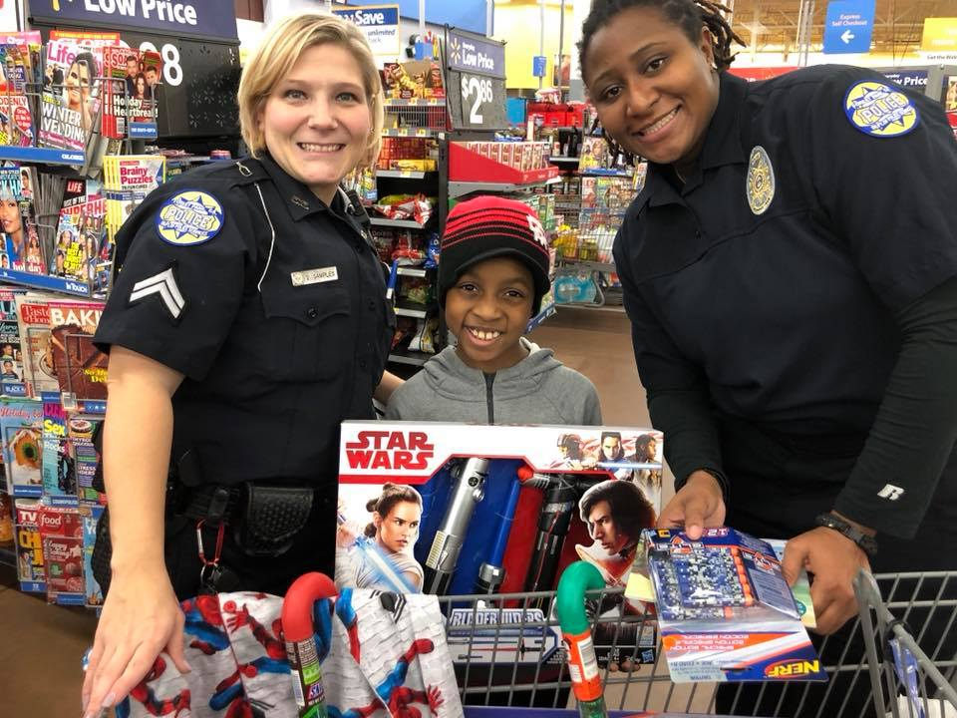
Patrol Goals 2017
Reduce Part-One Crimes by 10%
Increase recruiting and retention.
Decrease Highway/Street accidents by 10%
Increase management/supervision training.
2017 “Shop with a Cop”
12

Slide 14
Accident Reduction
Officers constantly strive to reduce traffic accidents with accident reduction patrols and aggressive traffic enforcement, not only to reduce deaths, injuries and property damage, but also to help deter crime in the process.
13

Slide 15
Captain
James Delk
Chief of Detectives
Captain James Delk began his law enforcement career at the Forest Park Police Department in 1995. He was assigned to the Uniform Patrol Division. A few years later he became the departments Drug Abuse Resistance Education, D.A.R.E., Instructor. D.A.R.E. provides education about the dangers of alcohol and drug use to elementary aged children. While in the D.A.R.E. program, he was promoted to the rank of sergeant and was re-assigned to the Uniform Patrol Division. Shortly thereafter he was promoted to the rank of lieutenant.
In 2006 he was transferred, at the rank of lieutenant, to the Criminal Investigations Division. His responsibilities ranged from being one of the department’s Public Information Officers, responsible for the preparation and presentation of media releases, to conducting criminal investigations; background investigations; and preparing and maintaining departmental records. He is also trained as a Hostage Negotiator.
In May of 2015 he was promoted to the rank of Captain and is now in charge of the Criminal Investigations Division. He is responsible for Criminal Investigations, the Crime Scene Investigation Unit, as well as Internal Affairs. If you were to ask Captain Delk what he defines as success in life, he would tell you being a father to his two children and a husband to his wife of more than thirty years are his greatest accomplishments.
14

Slide 16
Part I Crimes
Two-year crime/arrest comparison
Part 1 Crimes Reported
Crimes | 2016 | 2017 | % Difference
Murder | 4 | 5 | -25%
Rape | 20 | 10 | -50%
Robbery | 72 | 57 | -21%
Agg. Assault | 65 | 60 | -8%
Burglary | 228 | 221 | -3%
Theft | 698 | 762 | 9%
Auto Theft | 140 | 139 | -1%
Arson | 6 | 3 | -50%
TOTAL | 1,233 | 1,257 | 2%
Part 1 Arrests
Crimes | 2016 | 2017 | % Difference
Murder | 2 | 1 | -50%
Rape | 1 | 2 | 100%
Robbery | 23 | 6 | -74%
Agg. Assault | 38 | 34 | -10%
Burglary | 32 | 26 | -19%
Theft | 126 | 152 | 21%
Auto Theft | 11 | 12 | 9%
Arson | 1 | 2 | 100%
TOTAL | 234 | 235 | NA
15

Slide 17
Criminal Investigations
CID Case Assignment/Activity 2016 & 2017
 | 2016 | 2017
Cases Assigned | 1,477 | 1,287
Ex-Cleared | 211 | 203
Cleared by Arrest | 478 | 387
Unfounded | 64 | 69
Total Cleared | 753 | 659
Inactive | 724 | 628
16

Slide 18
Internal Affairs
Internal Affairs Investigations (Level I) | 1st Qtr | 2nd Qtr | 3rd Qtr | 4th Qtr | YTD
# Of cases Founded / Sustained | 0 | 1 | 1 | 0 | 2
Not Sustained | 0 | 0 | 0 | 0 | 0
# Of cases Unfounded | 0 | 1 | 1 | 0 | 2
Exonerated / Cleared | 0 | 0 | 0 | 0 | 0
Total # of IA | 0 | 2 | 2 | 0 | 4
Other Complaints (Level II) | 1st Qtr | 2nd Qtr | 3rd Qtr | 4th Qtr | YTD
# Of cases Founded / Sustained | 2 | 1 | 0 | 1 | 4
Not Sustained | 1 | 3 | 1 | 0 | 5
# Of cases Unfounded | 7 | 5 | 2 | 4 | 18
Exonerated / Cleared | 2 | 0 | 0 | 0 | 2
Open Status | 0 | 0 | 0 | 0 | 0
Total # of Citizen Complaints | 12 | 11 | 5 | 5 | 29
2017 Level I & II Investigations
17

Slide 19
Major
Jamie Reynolds
Administration & Communications
Major Jamie Reynolds began his law enforcement career with the Forest Park Police Department in January 1995. He spent the next four years as a patrol officer before being transferred to the Community Oriented Police Services (C.O.P.S) unit.
Major Reynolds was promoted to sergeant and then later lieutenant in March 2001. He achieved POST Supervision and Management certifications and obtained his Associate Degree from Georgia Military College. In September 2002, he was promoted to captain.
Major Reynolds continued his professional development by attending Columbus State University’s Professional Management Program and Command College and obtained his Bachelors Degree. While serving as a Watch Commander he not only maintained supervision control over his assigned team, but served on the North Georgia Anti-Terrorism Advisory Council and developed a Buffer Zone Protection Plan for Clorox. . He recently graduated from Columbus State University with a Master Degree in Public Administration and plans to continue his education through additional leadership training.
In February 2006, he was transferred from Operations to Administration where he currently supervises Communications, C.O.P.S., Emergency Preparedness, CALEA, Training, and other administrative assignments. In January 2012, he was promoted to Major. In November of 2016 he completed the Southern Police Institute Administrative Officers Course at the University of Louisville.
Major Reynolds has played a vital role in the revitalization of the Neighborhood Watch Program, remodeling the 911 Center, re-banding of 800 MHz frequencies on city radios, obtaining over one million dollars in grants, development of Forest Park’s CRI plan, implementation of OSSI CAD software, development and implementation of the Rapid ID pilot program, CALEA reaccreditations, and migration from a conventional to a trunked radio system.
18

Slide 20

Administrative Supervisor
Susan Ridling
Susan is a native of Forest Park, where she attended and graduated with the class of 1980 at Forest Park Senior High School, and continued her education through Clayton State University.
In 1984 she began her career with the City of Forest Park as the Executive Assistant to the Mayor and City Manager. In 1991, she transferred into the Police Department as the Senior Assistant to the Chief of Detectives. In 1996 she was promoted to the Executive Assistant to the Chief of Police.
Her skills and institutional knowledge has enhanced her responsibilities to manage four administrative staff assistants, overseeing information technology, purchasing, payroll, and crime analysis.
19

Slide 21
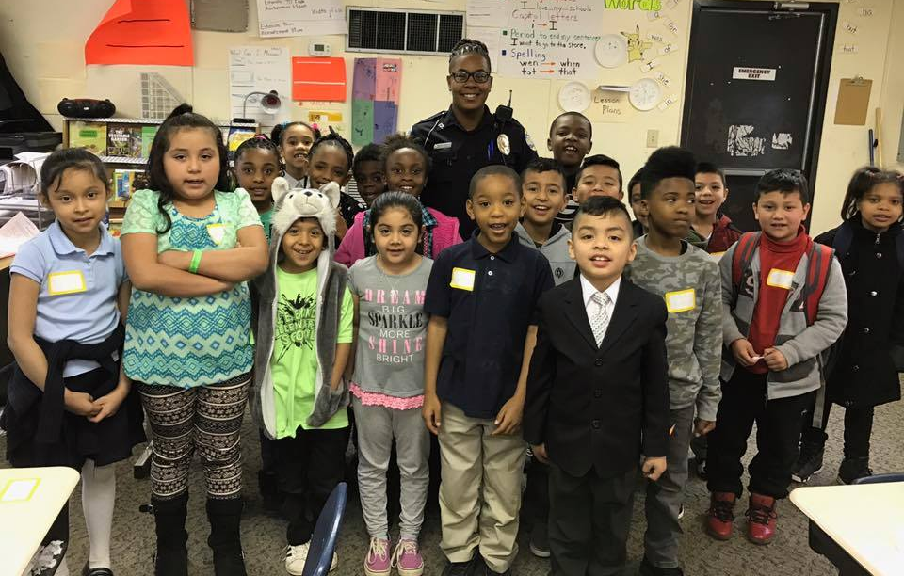
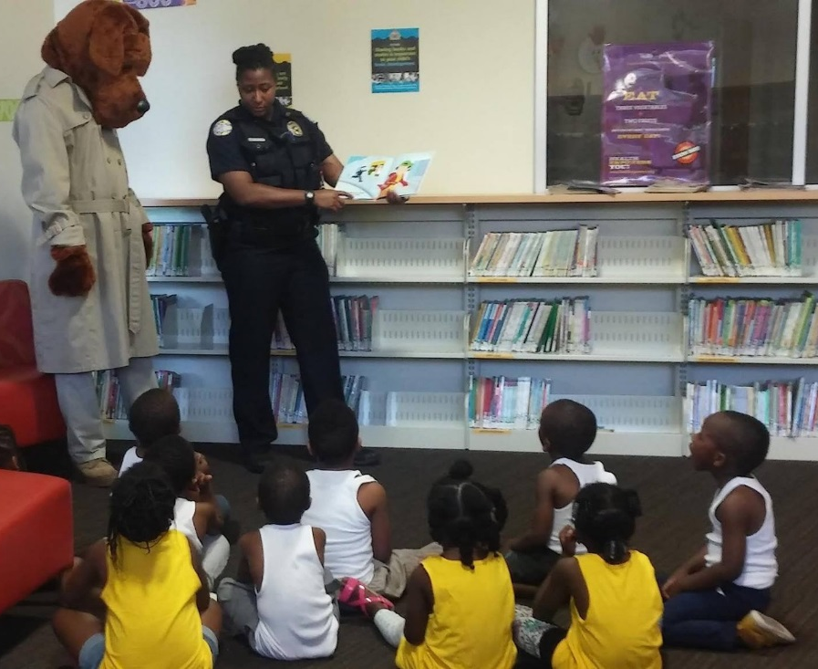
Community Oriented Policing
Crime Prevention Programs
Apartment Managers Coalition
Neighborhood Watch
Citizen Police Academy
Hispanic Citizen Police Academy
THOR (target hardening opportunity reduction)
MARC ID (merchant awareness reduces crime)
Forest Park PRIDE
LEEP (larceny education & enforcement program)
TRIAD
Operation ID
National Night Out
Neighborhood Watch
In 2017, one meeting was held the third Thursday of every month. Neighborhood Watch remains one of the most effective means of developing close contact between police officers and the public. During these meetings, officers provided crime prevention information, data on specific and receive feedback on citizens’ perceptions of our police services.
Officer Walker and McGruff the Crime Dog read to children at the Forest Park Library
20

Slide 22
Training
Training Topics in 2017 included:
Basic Radar Certification
Legal Updates
Defensive Tactics
Firearms Requalification
Use of Force/Deadly Force
Dealing with Mentally Ill
Defensive Driving
Crime Scene Photography
TASER
CIT (Crisis Intervention Team)
Report Writing
Bias Based Profiling
Leadership Training
Mobile Field Force Training
CPR / AED
Bleeding Control
Ongoing professional, development, and in-service training is provided at the Forest Park Police Department on a regular basis throughout the year. In addition to POST certification training provided at regional and state police academies, the staff of instructors at the Forest Park Police Department conduct training for both new and seasoned personnel.
There are fifteen certified instructors with FPPD and many hold both general instructor certifications and specialized certifications in areas such as TASER, Firearms, and Defensive Tactics. Having personnel with these credentials allows us to conduct a great deal of needed training in-house. Training needs are constantly evaluated and programs developed in coordination with shift commanders, supervisors and Chief Hobbs.
In 2017 Forest Park Police Officers received 8,492 hours of POST approved training.
21

Slide 23
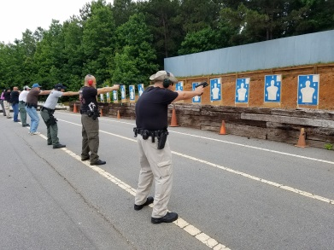
Firearms Training
Deadly force is the force an officer uses that would create a substantial risk of causing death, serious bodily harm or injury. The use of deadly force is justified only under conditions of extreme necessity as a last resort, when all lesser means have failed or cannot reasonably be employed. Firearms training helps to develop a conditioned response in officers as they obtain their sight picture and alignment, while meeting the departmental training standards. This response is critical in the first split-second of a deadly force situation.
Firearms Requalification and Use of Deadly Force training was held in May of 2017.
The awards presented are as follows:
Top Team – Baker Team Average score of 264/300.
Top Gun - Lieutenant Cochran shot 296/300.
Moorefield’s Possible Award - Sergeant Yermack
Overall Department 1st Round Average- 260.6/300
Forest Park uses the state mandated 30 round Standard Qualification Course. The maximum points for the course is 300. Officers must score a minimum of 80%, or 240 points, to pass. Firearms Instructors must score 90%, or 270 points, to instruct for the department. Awards are given for “Top Team” and “Top Gun”. “Moorefield’s Possible” awards are given to anyone that shoots a perfect score at any point during qualification.
22

